Slide 1
HYF .NET Masterclass 2022
Week 4

Slide 2
Agenda for today
Recap on Week #3 and homework
A quick look at Model-View-Controller in a real life web site
Interfaces
Service classes and Dependency Injection
Mealsharing

Slide 3
Homework recap
Enums – what are they and how do they work?
Returning list of objects – or IEnumerables
Discussion – what would be the best approach for a converter?

Slide 4
Real-life MVC CMS example
Models are content types
Editorial interface
Example is Optimizely (Episerver) CMS – but Umbraco would be very similar

Slide 5
Interfaces
Describes certain characteristics (Signatures) on a class.
If a class implements that interface, it must implement everything described in the interface
Any class can implement any number of interfaces
Often used as a substitute for multiple inheritance
Naming standard: Start with “I”

Slide 6
Demo

Slide 7


Design Pattern: Inversion Of Control

Slide 8
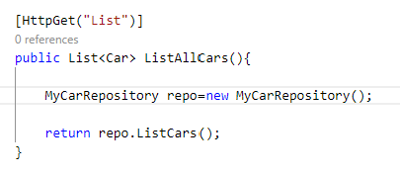
IoC: What is the problem
Business logic should be separated out into re-usable classes
But the above will make a ‘hard’ dependency on that specific business logic class, MyCarRepository.
If there in the future is another MyCarRepository that should be used, you will also have to change it here.

Slide 9
IoC problem cont’d
Problem if your code is being used as a library – nothing can easily be replaced in it without full source code.
Problem for Unit testing if you want to use Mock versions of business logic

Slide 10
Solution: Inversion of Control
Have ‘something’ provide the correct implementation for any requested type/interface dynamically.
For example using “Service Locator” pattern
Or use “Dependency Injection” to have it injected in the classes that need it.
Standard with Dependency Injection in ASP.NET Core.

Slide 11
Register services in Startup or Program
Builder.Services.AddTransient Transient services are created when needed and disposed instantly
Builder.Services.AddScoped Scoped services are created when needed, but kept throughout the current request
Builder.Services.AddSingleton Singletons are kept as long as the web application is running. Singleton is also a ‘Pattern’ for a class of which there is only one implementation which is never disposed.

Slide 12
Use services in controller
Constructor injection
Service Locator
Injected Properties
@injected in razor

Slide 13

Demo

Slide 14
Mealsharing App
Web API
Which Models?
Which Controllers?
Which Services?

Slide 15
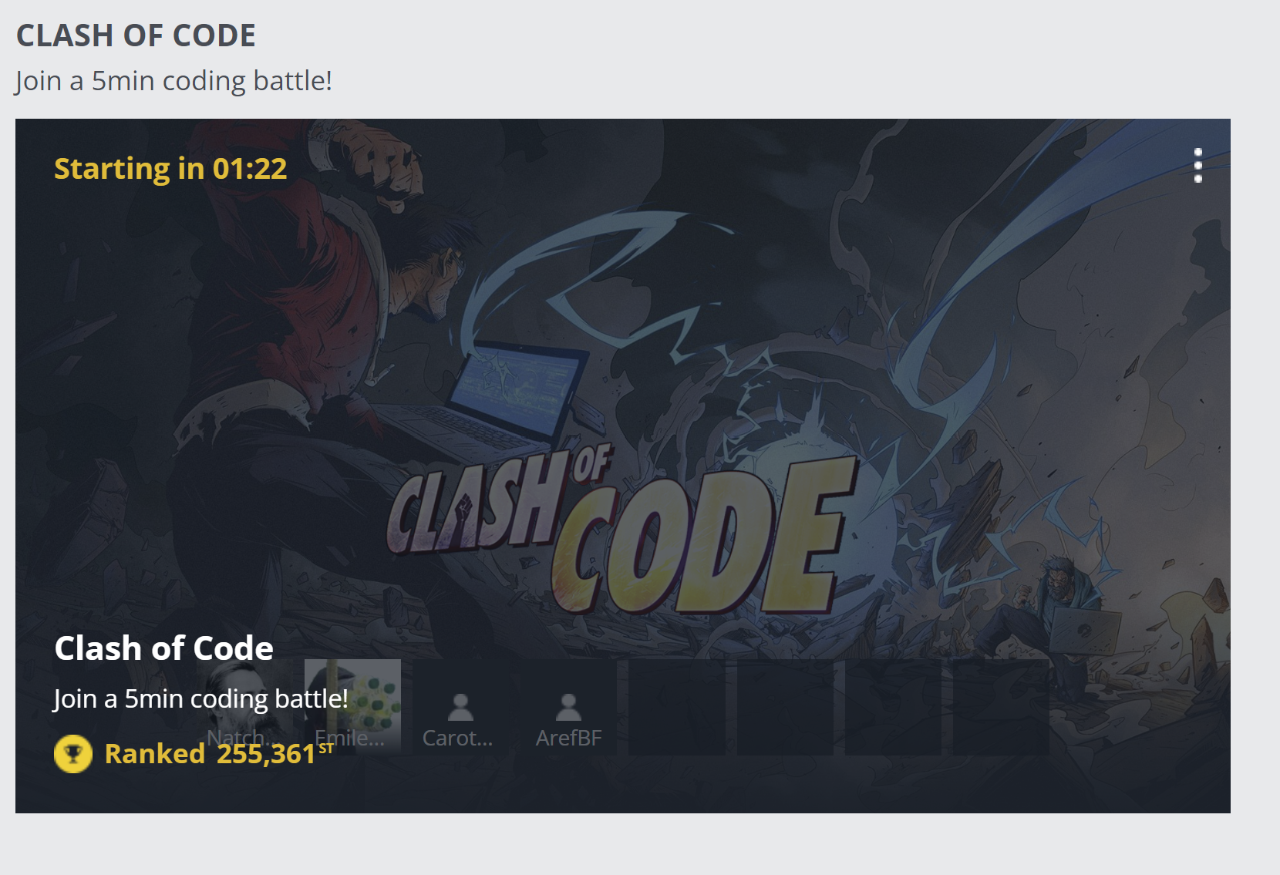
Codingame.com

